Slide 1
FINDING NEW MEMBERS FOR YOUR CLUB!

Slide 2
WHY DO WE NEED NEW MEMBERS?

Slide 3
BENEFITS TO CLUB
FILL ALL AGENDA ROLES – BETTER MEETING PROGRAMS
NEW VIEWPOINTS
CREATES A VIBRANT CLUB ATMOSPHERE
ACHIEVES DCP MEMBERSHIP GOALS

Slide 4
BENEFITS TO NEW MEMBER
BUILDS CONFIDENCE
BUILDS COMMUNICATION SKILLS
BUILDS LEADERSHIP SKILLS
BUILDS SOCIAL SKILLS

Slide 5
HOW DO WE FIND NEW MEMBERS?

Slide 6
PERSONALLY
INVITE FAMILY, FRIENDS & WORK COLLEAGUES
SHARE YOUR EXPERIENCES
WEAR YOUR TOASTMASTERS PIN

Slide 7
PUBLICLY
MARKET YOUR CLUB
CLUB WEBSITE
Keep it updated
SOCIAL MEDIA
Facebook
Meet-up
Website
LOCAL NEWSPAPER
FLYERS
MAGAZINE DROPS

Slide 8
HOW DO WE CONVERT GUESTS INTO MEMBERS?

Slide 9
BY CREATING A BUZZ IN YOUR CLUB!

Slide 10
WHY HAVE A BUZZING CLUB?

Slide 11
BUILDS CLUB MEMBERSHIP
MEMBERS REMAIN IN THE CLUB LONGER
BUILDS CAMARADERIE

Slide 12
THINK ABOUT YOUR CLUB…………..

Slide 13
You NEVER get a second chance at a first impression!

Slide 14
IS YOUR VENUE WELCOMING?
HAVE YOUR MEMBERS GREET & WELCOME GUESTS

Slide 15
ASK GUESTS TO SIGN THE VISITORS BOOK

Slide 16
SIT GUESTS NEXT TO AN EXPERIENCED MEMBER WHO CAN EXPLAIN THE AGENDA TO THEM

Slide 17
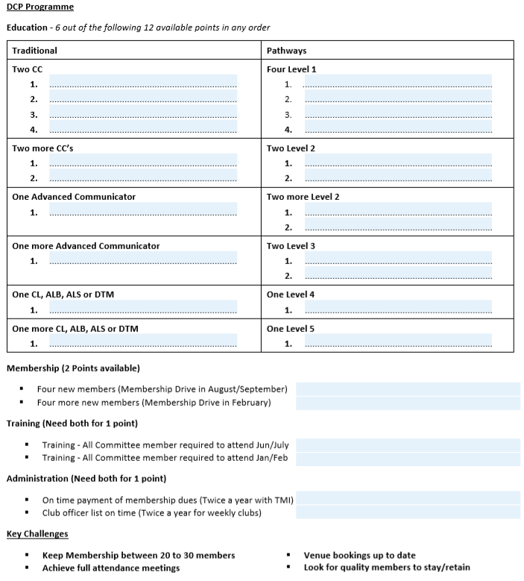
HAVE YOUR DCP PROGRESS ON DISPLAY

Slide 18
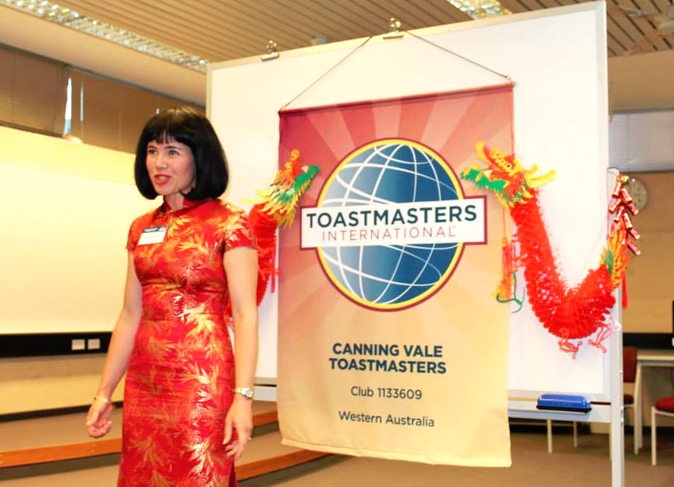
SAA OR TOASTMASTER WELCOMES GUESTS BY NAME IN OPENING ADDRESS

Slide 19
ACTION PACKED AGENDA
MEETING BEGINS & ENDS ON TIME

Slide 20
TABLE TOPICS MASTER ASKS GUESTS TO PARTICPATE

Slide 21
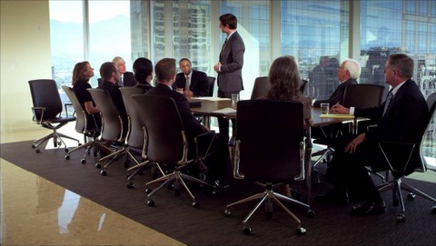
PRESIDENT ASKS GUESTS IF THEY ENJOYED THE MEETING & IF THEY WILL JOIN OR VISIT AGAIN

Slide 22
MEMBERS CHAT TO GUESTS AFTER THE MEETING TO ANSWER QUESTIONS

Slide 23
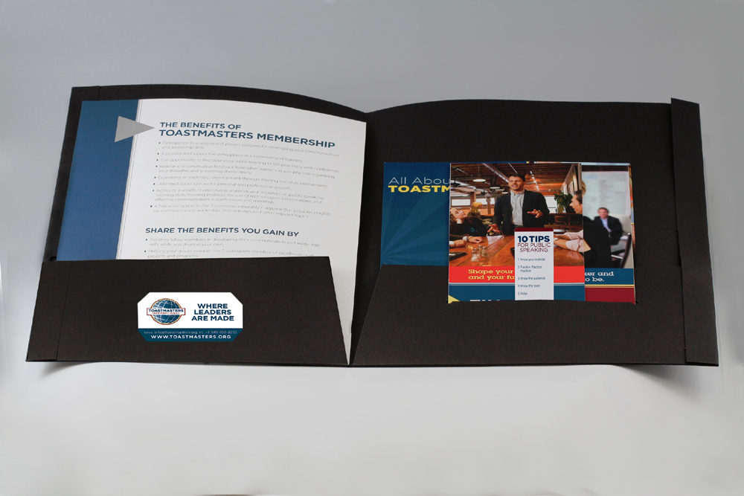
GIVE GUESTS A TAKE HOME PACK WITH A MEMBERSHIP FORM, TOASTMASTER MAGAZINE AND OTHER INFORMATION

Slide 24
SEND A THANK YOU NOTE, PHONE OR EMAIL TO INVITE AGAIN

Slide 25
SUMMARY
WHY WE NEED NEW MEMBERS
HOW WE FIND PROSPECTIVE NEW MEMBERS
HOW WE CONVERT GUEST TO MEMBERS
HOW WE MAINTAIN OUR MEMBERSHIP WITH A BUZZING CLUB

Slide 26
GET YOUR CLUB BUZZING WITH NEW MEMBERS!

