Slide 1
Embracing the Pathways Program
Kaylene Ledgar DTM
Past Region 12 Advisor

Slide 2
Session Overview
Understanding Pathways
Making Pathways work for YOU
Embracing
Pathways Program

Slide 3
Understanding Pathways
Don’t know
Enrolled but not active
Embracing Pathways Program
Know & not interested at all
Completing Projects & Levels

Slide 4
Overview of Pathways
11 learning paths
300 unique skillset competencies
5 core competencies
Public Speaking
Interpersonal Communication
Strategic Leadership
Management
Confidence
Complete Level 2 in any path
to access FREE Mentor Path

Slide 5
Learning Path
5 levels
Mastering fundamentals
Learning your style
Increasing your knowledge
Building skills
Demonstrating expertise
Required & Electives
Path Completion

Slide 6
Making Pathways work for YOU

Slide 7
Working Your Learning Path
Get comfortable with Base Camp
Know your path
What are the required projects?
What are the electives?
Plan what projects to work on next
You don’t need to complete projects & levels in order.

Slide 8
Club Meeting Roles
Before level 3 is marked complete by Vice President Education you must serve in these three meeting roles
Update completed meeting roles in base camp my account
Speech Evaluator
Evaluation & Feedback Level 1
Table Topics Master
Active Listening Level 2 required or Level 3 elective
Toastmaster of Meeting
Successful Collaboration Level 3 required Team Collaboration

Slide 9
Outside of Toastmaster
Family or work celebration speeches
Deliver Social Speeches Level 3 elective
Keynote speaker
Question and Answer Session Level 4 elective
Prepare to Speak Professionally Level 5 required or elective
Personal or professional project
High Performance Leadership Level 5 required or elective
Manage Projects Successfully Level 4 elective

Slide 10
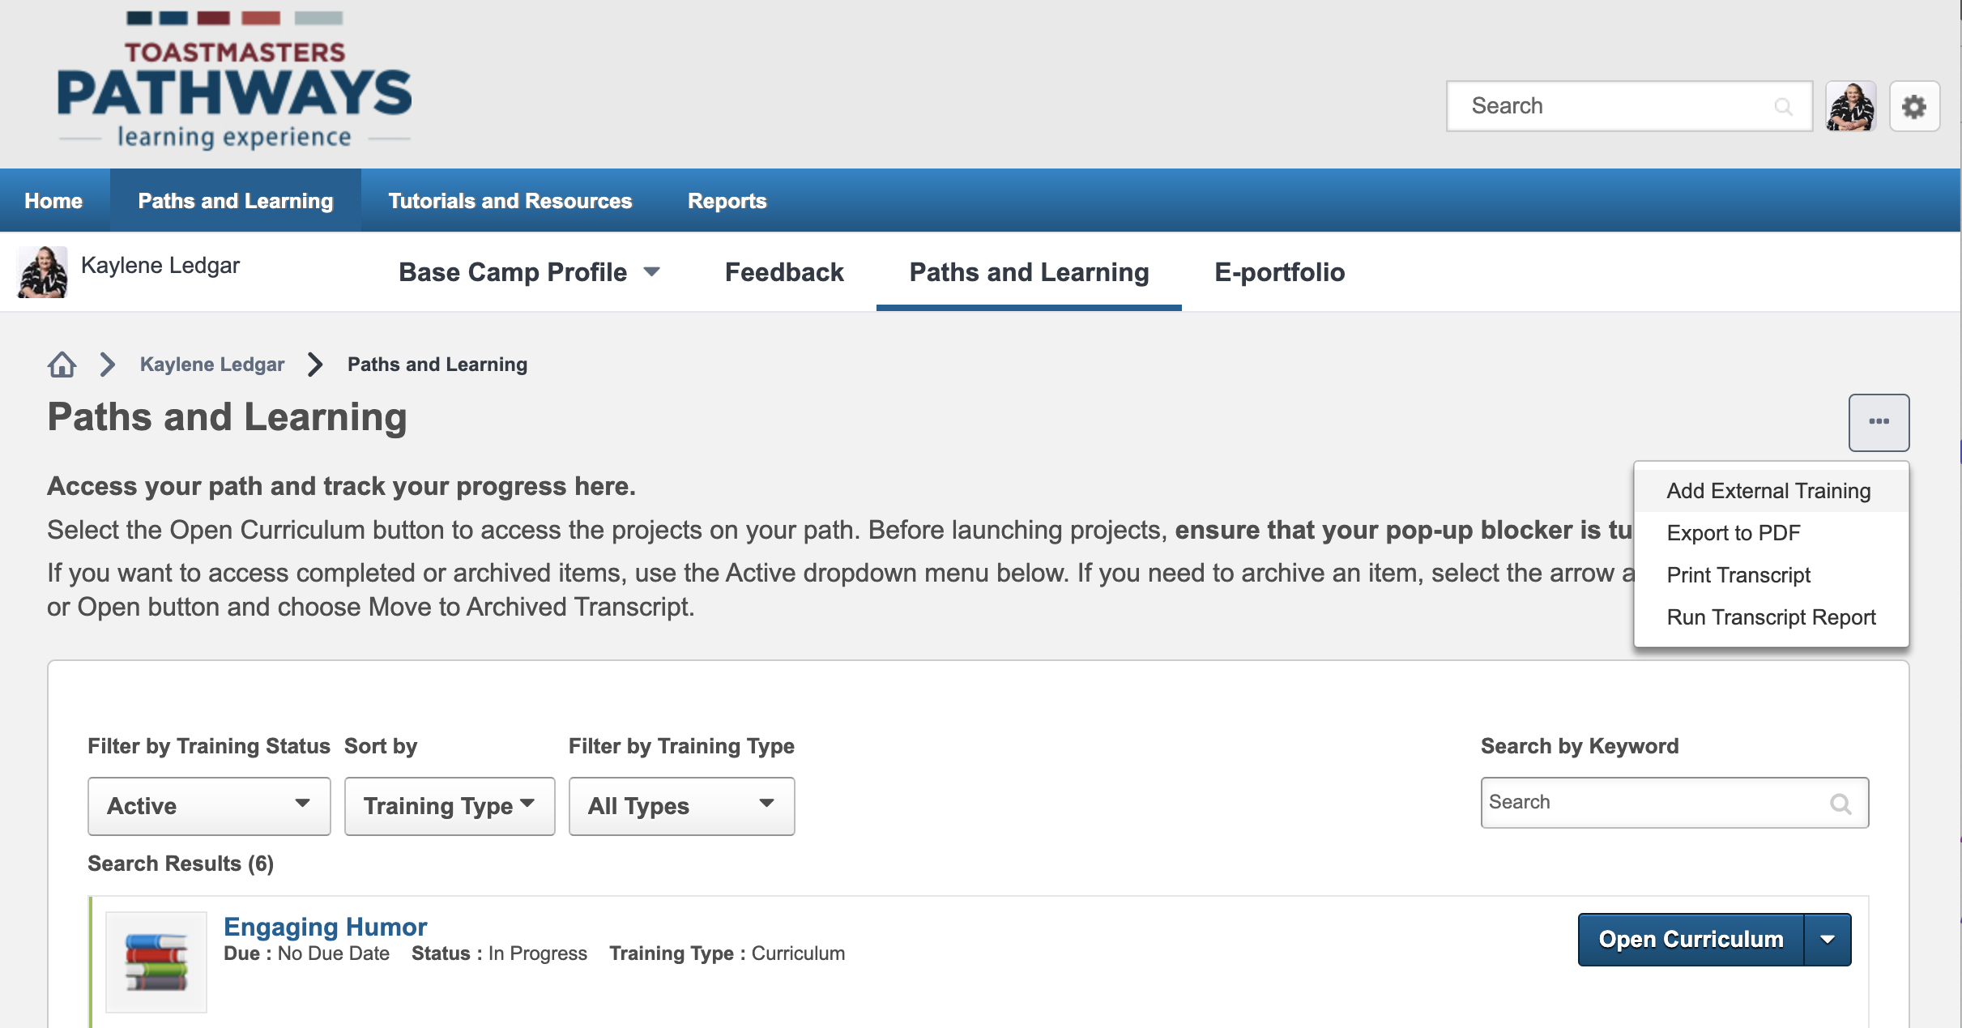
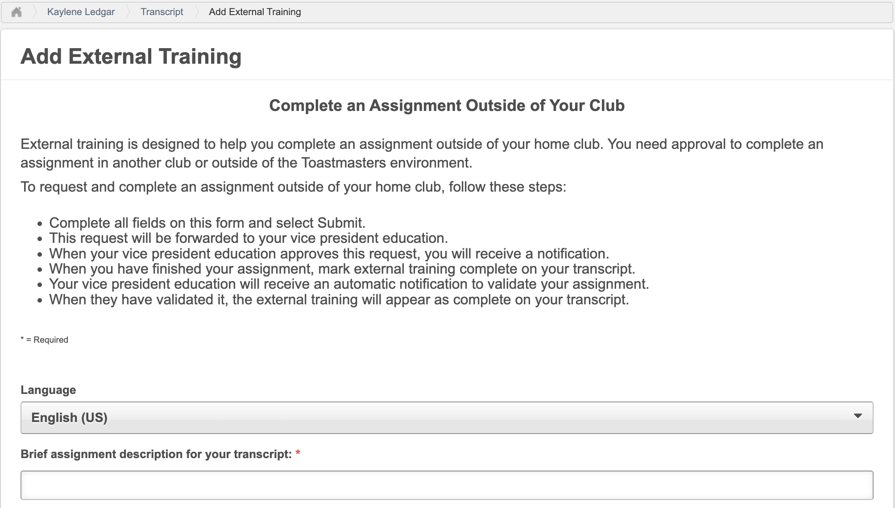
External Training
Speeches, projects & events outside of home club
Test Speaker in an evaluation contest
Competing in a speech contest

Slide 11
Club Officer
High Performance Leadership*
Lead in Any Situation
Dynamic Leadership & Team Collaboration
Leading in Your Volunteer Organization
Manage Change
Dynamic Leadership
Manage Projects Successfully*
Motivate Others
Motivational Strategies & Team Collaboration
Successful Collaboration
Team Collaboration
Team Building
Motivational Strategies
* All Paths

Slide 12
Public Relations
Building a Social Media Presence*
Create a Podcast* (audio or video)
Manage Projects Successfully*
Motivate Others
Motivational Strategies & Team Collaboration
Public Relations Strategies*
Successful Collaboration
Team Collaboration
Write a Compelling Blog*
* All Paths

Slide 13
Organising Club Meetings & Events
Meetings & Events
Pathways Projects
Club Contests
Club Meetings
Special Events
Online Meetings
High Performance Leadership*
Manage Projects Successfully*
Motivate Others
Motivational Strategies & Team Collaboration
Successful Collaboration
Team Collaboration
Team Building
Motivational Strategies
Manage Online Meetings*
* All Paths

Slide 14
Supporting Club Initiatives
Club Initiatives
Pathways Projects
Mentor Program
New Member Orientation
Visitor Experience
High Performance Leadership*
Lead in Any Situation
Dynamic Leadership & Team Collaboration
Leading in Your Volunteer Organization
Manage Projects Successfully*
Motivate Others
Motivational Strategies & Team Collaboration
Successful Collaboration
Team Collaboration
* All Paths

Slide 15
How are you going to make Pathways work for you this year?

Slide 17
“If you get out of Toastmasters all you can get out of Toastmasters, you’ll never get out of Toastmasters.” Helen Blanchard First female Toastmasters International President

